Slide 1

User Engagement Analysis

Slide 2

Hello!
I am Hans Peter Ndeffo
We will focus on how showwcase can improve its users involvement

Slide 3
1. Exploring the problem using a strategic business analysis approach

Slide 4
Strategic Business Analysis is based on S.W.O.T process which focus on
Strengths: Use charts to see how most engaged users behave over time and what to consider
Weaknesses: Less involved users
Opportunities: How to improve users engagement
Threats: What significantly impact user engagement over time
.

Slide 5
Tracking User Activity by Inactive Status and session

Slide 6
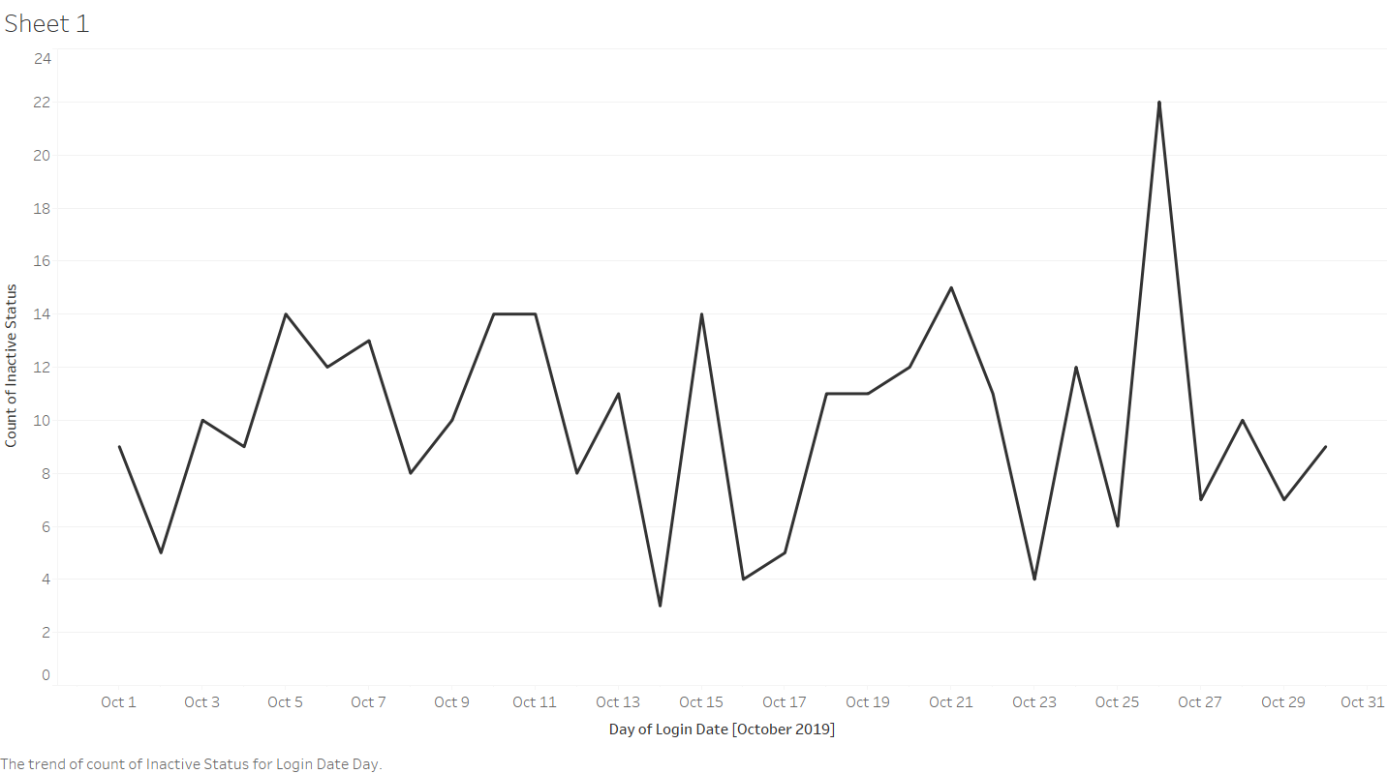

Slide 7
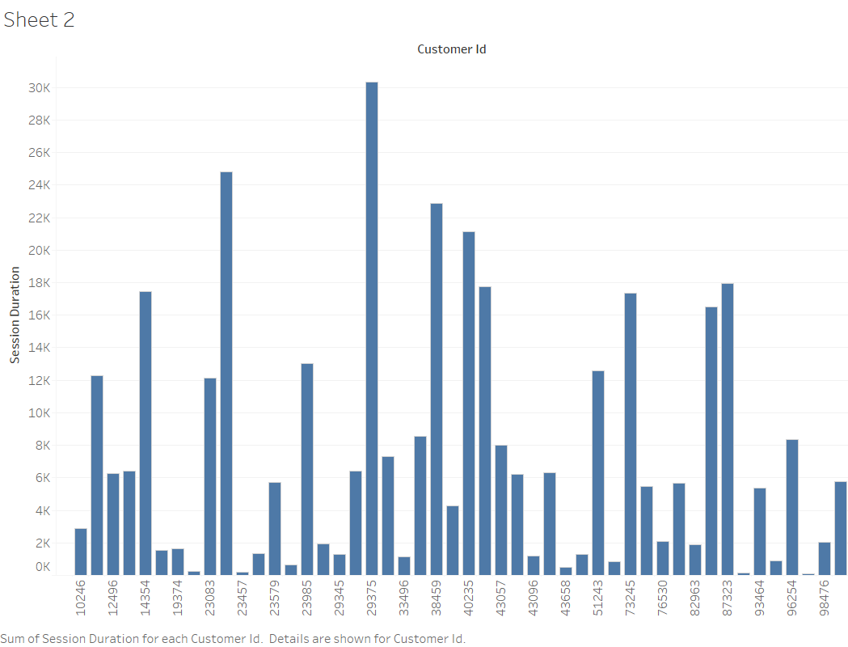

Slide 8
What is the behavior of 10% most active users by the number of times they have been inactive?

Slide 9
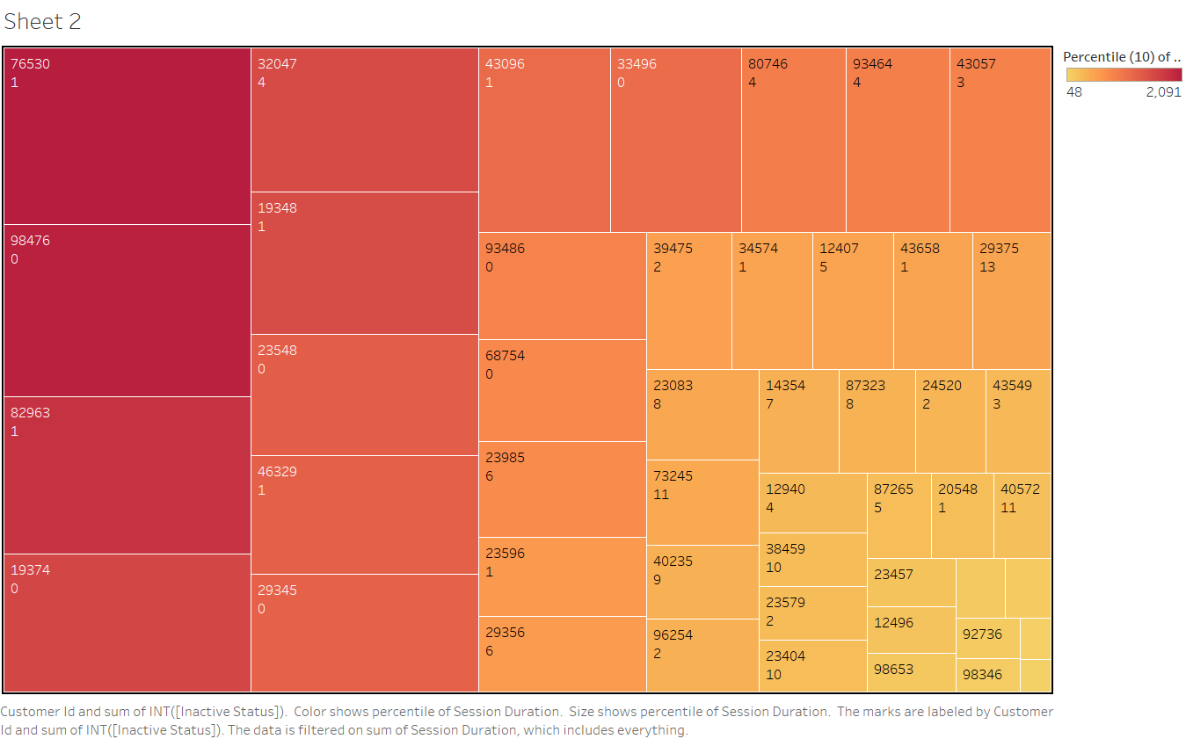

Slide 10
Why a strategic business analysis approach to assess this issue?

